Slide 1
+
QuickDoc
GitHub Repository
& Source Code Sample
Team 4 • CS691 • Pace University
[Team Member 1] - Project Manager
[Team Member 2] - Product Owner
[Team Member 3] - Business Analyst
[Team Member 4] - Lead Developer
[Team Member 5] - Developer
[Team Member 6] - QA Analyst
[Team Member 7] - Lead QA
[Team Member 8] - Software Tester
[Team Member 9] - Software Tester
[Team Member 10] - Software Tester

Slide 2



Agenda
GitHub
Repo URL | Repo Structure | Prerequisites | Installation
Code Snippets
Frontend | Backend
Deployment
Jenkins | CI/CD Pipeline
QuickDoc | Team 4 | CS691 | Pace University

Slide 3
GitHub Repository
GitHub URL:
https://github.com/raghavathyagaraj/QuickDoc/tree/develop
114 Commits | 3 Branches | 84 Deployments
QuickDoc | Team 4 | CS691 | Pace University

Slide 4
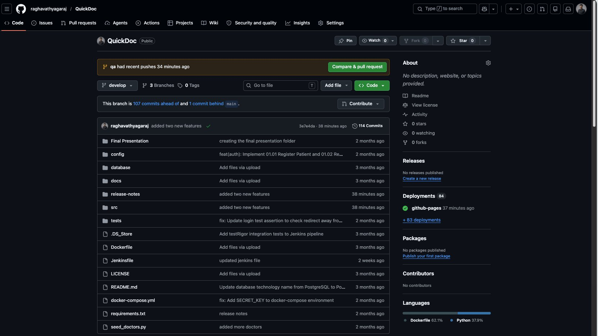
Repo Structure (Root)
QuickDoc | Team 4 | CS691 | Pace University

Slide 5
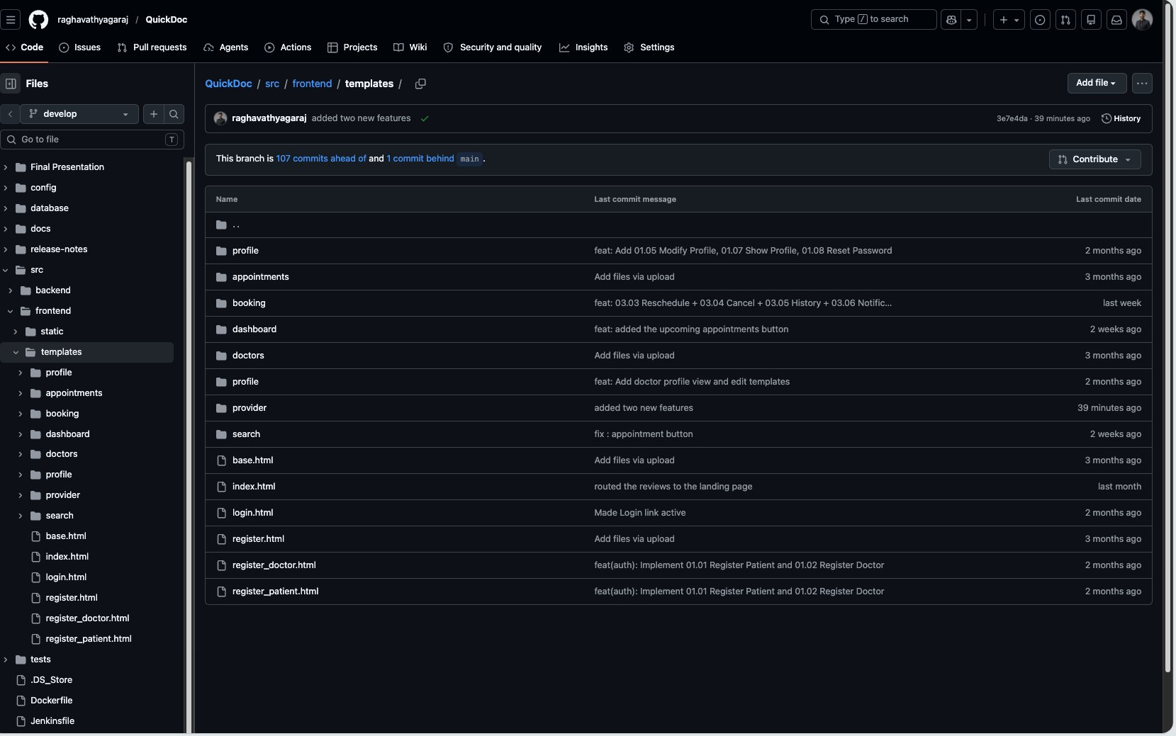
Repo Structure (Frontend - Templates)
QuickDoc | Team 4 | CS691 | Pace University

Slide 6
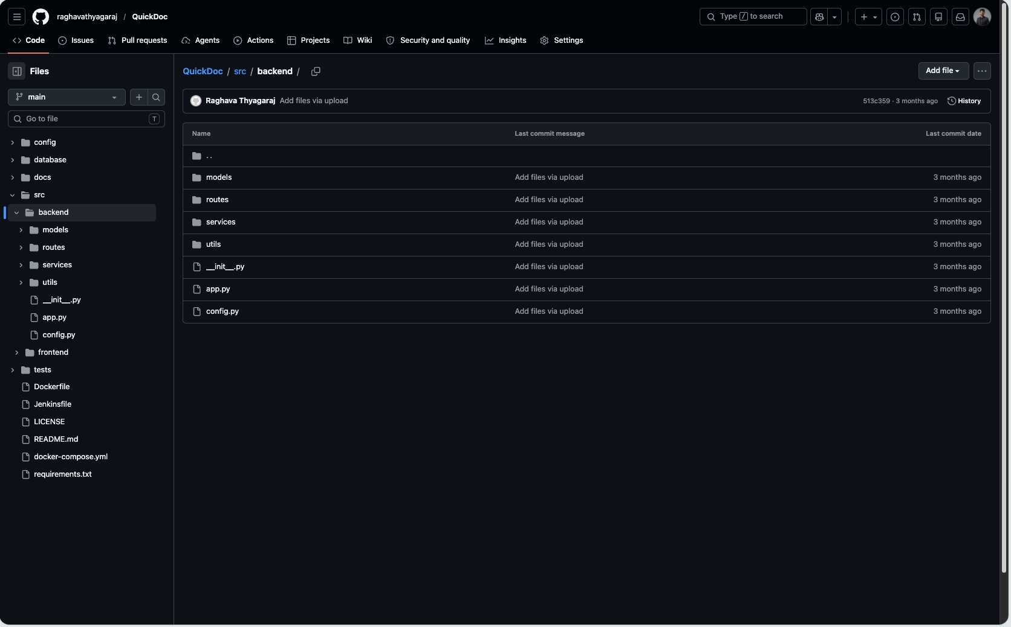
Repo Structure (Backend)
QuickDoc | Team 4 | CS691 | Pace University

Slide 7
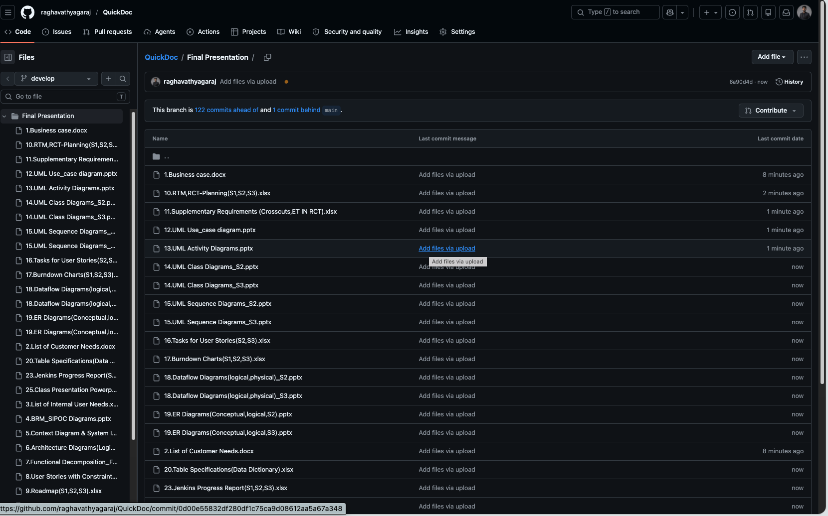

Repo Structure (Final Deliverables)
[ Screenshot Placeholder ]
Insert Final Deliverables folder screenshot here
QuickDoc | Team 4 | CS691 | Pace University

Slide 8




Prerequisites
Python 3.x
PostgreSQL
Backend runtime
Database server
IDEs
Docker
VS Code / PyCharm for Frontend & Backend
Containerized deployment
QuickDoc | Team 4 | CS691 | Pace University

Slide 9
Installation Guide
1
Clone the Repo
2
Install Dependencies
git clone https://github.com/
raghavathyagaraj/QuickDoc.git
git checkout develop
pip install -r requirements.txt
3
Setup Database
4
Run with Docker
Create PostgreSQL DB 'quickdoc'
Run: python seed_doctors.py
docker-compose up --build
App at http://localhost:5000
QuickDoc | Team 4 | CS691 | Pace University

Slide 10
Code Snippets

Slide 11
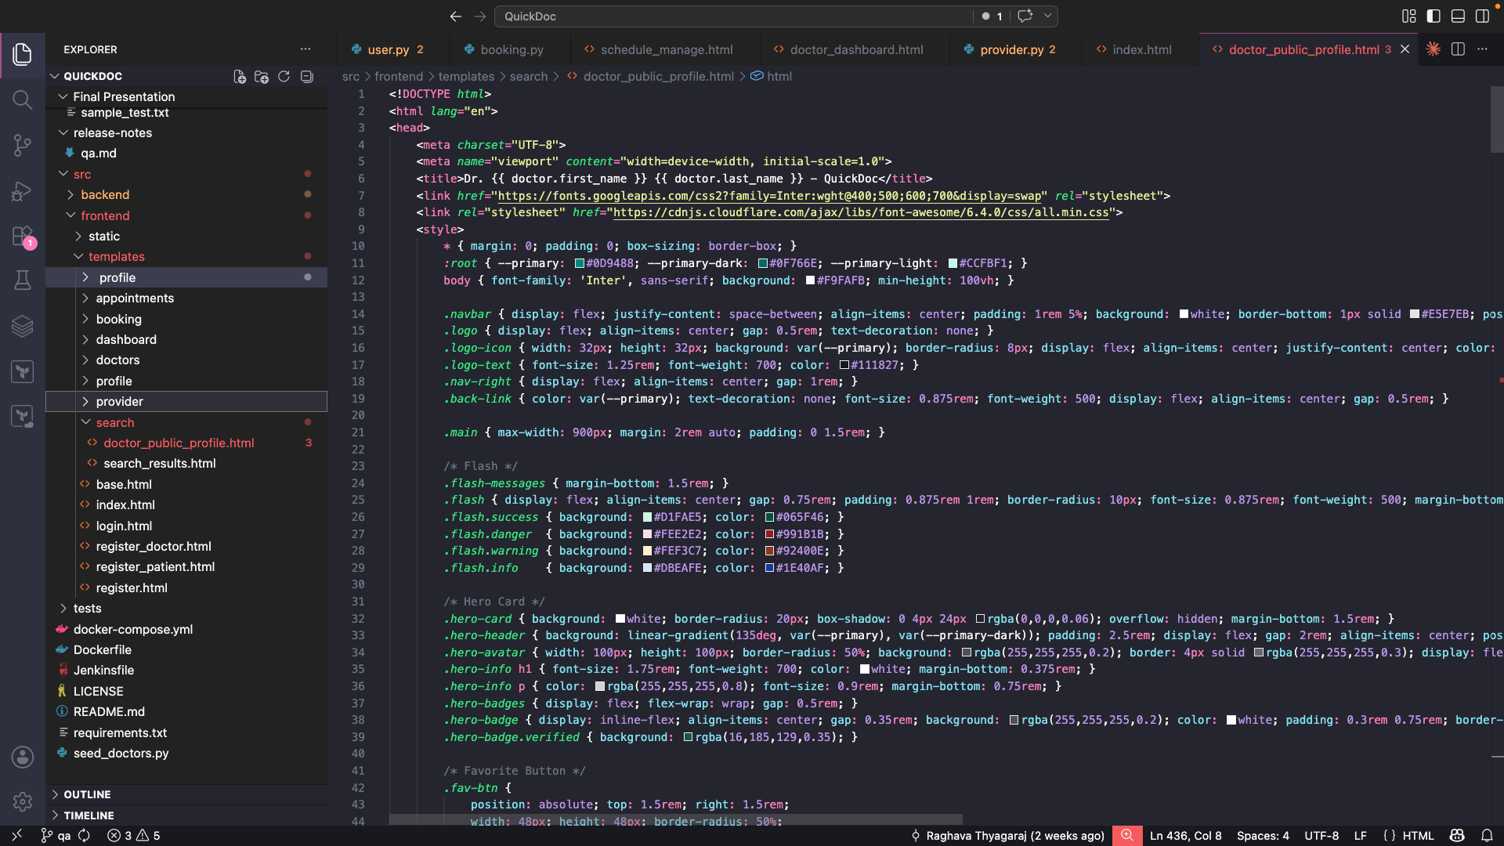
Doctor Search (Frontend)
[ Insert Frontend Code Screenshot ]
QuickDoc | Team 4 | CS691 | Pace University

Slide 12
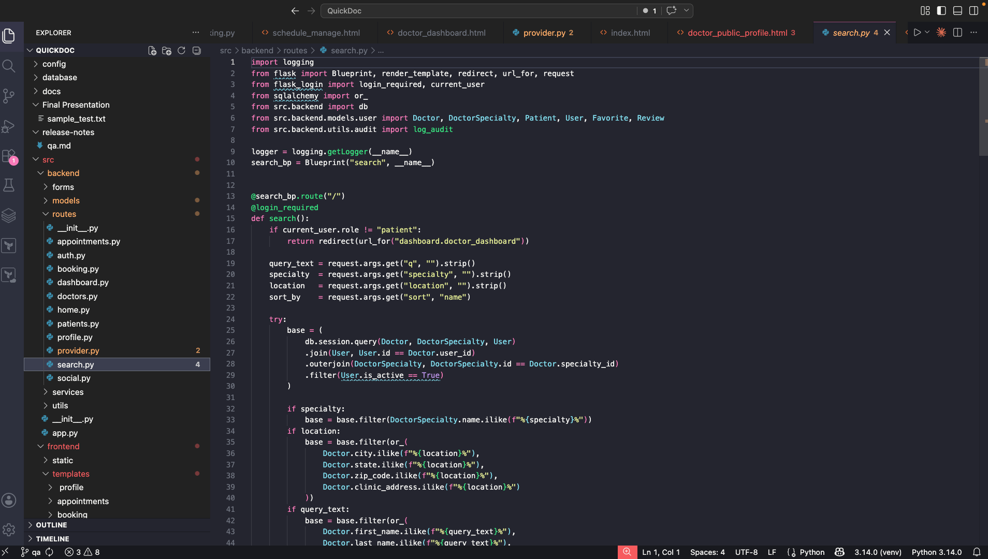
Doctor Search (Backend)
[ Insert Backend Code Screenshot ]
QuickDoc | Team 4 | CS691 | Pace University

Slide 13
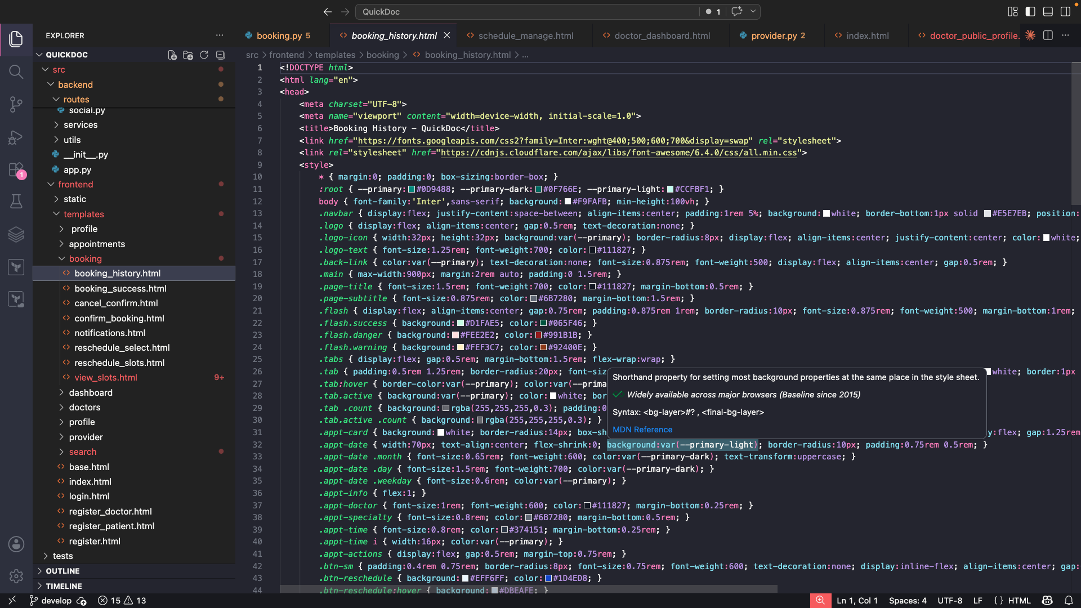
Appointment Booking (Frontend)
[ Insert Frontend Code Screenshot ]
QuickDoc | Team 4 | CS691 | Pace University

Slide 14
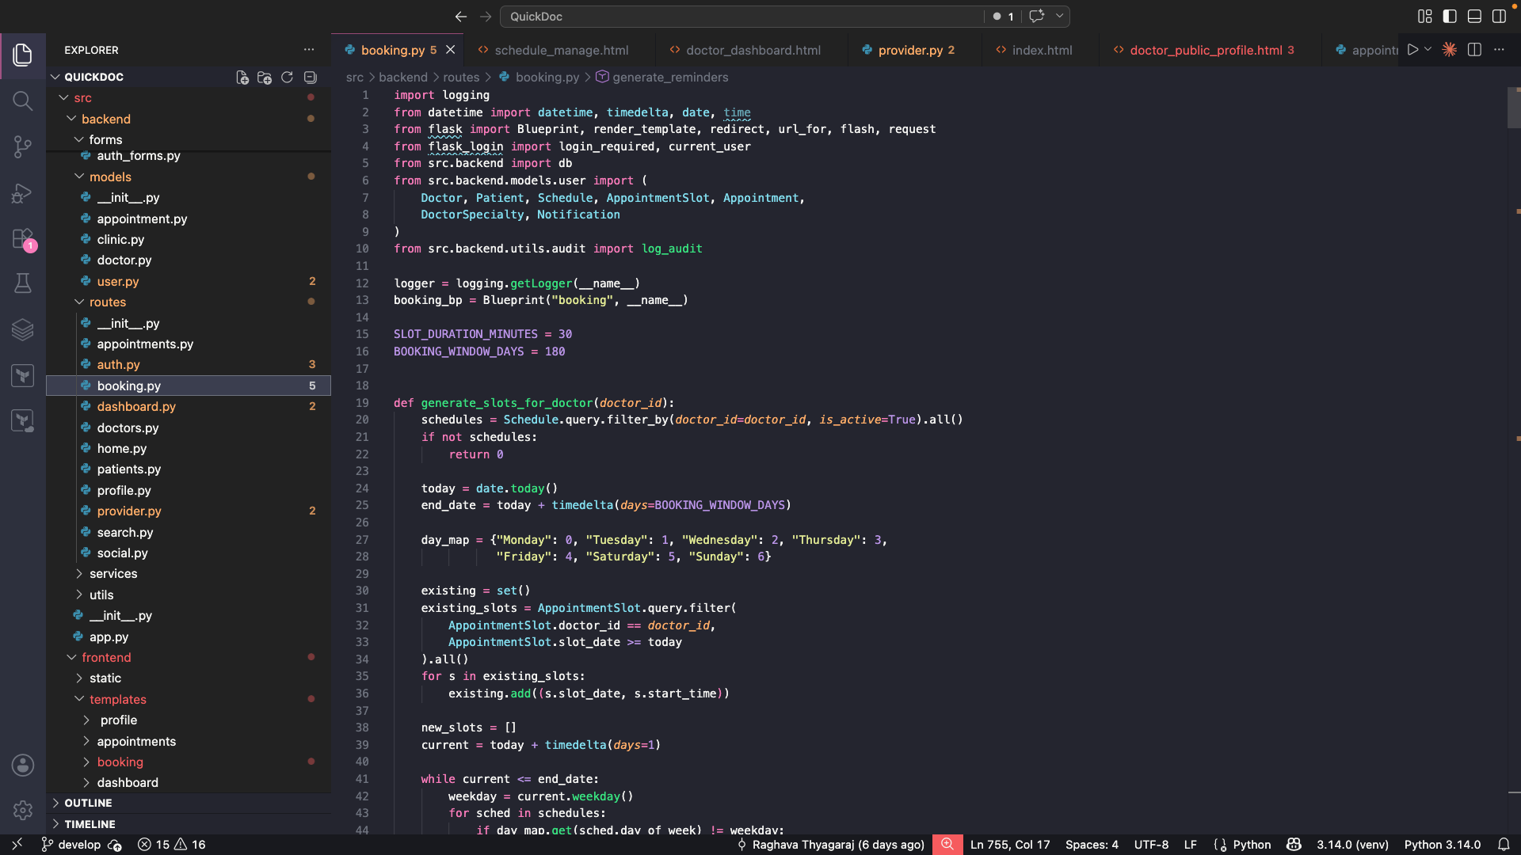
Appointment Booking (Backend)
[ Insert Backend Code Screenshot ]
QuickDoc | Team 4 | CS691 | Pace University

Slide 15
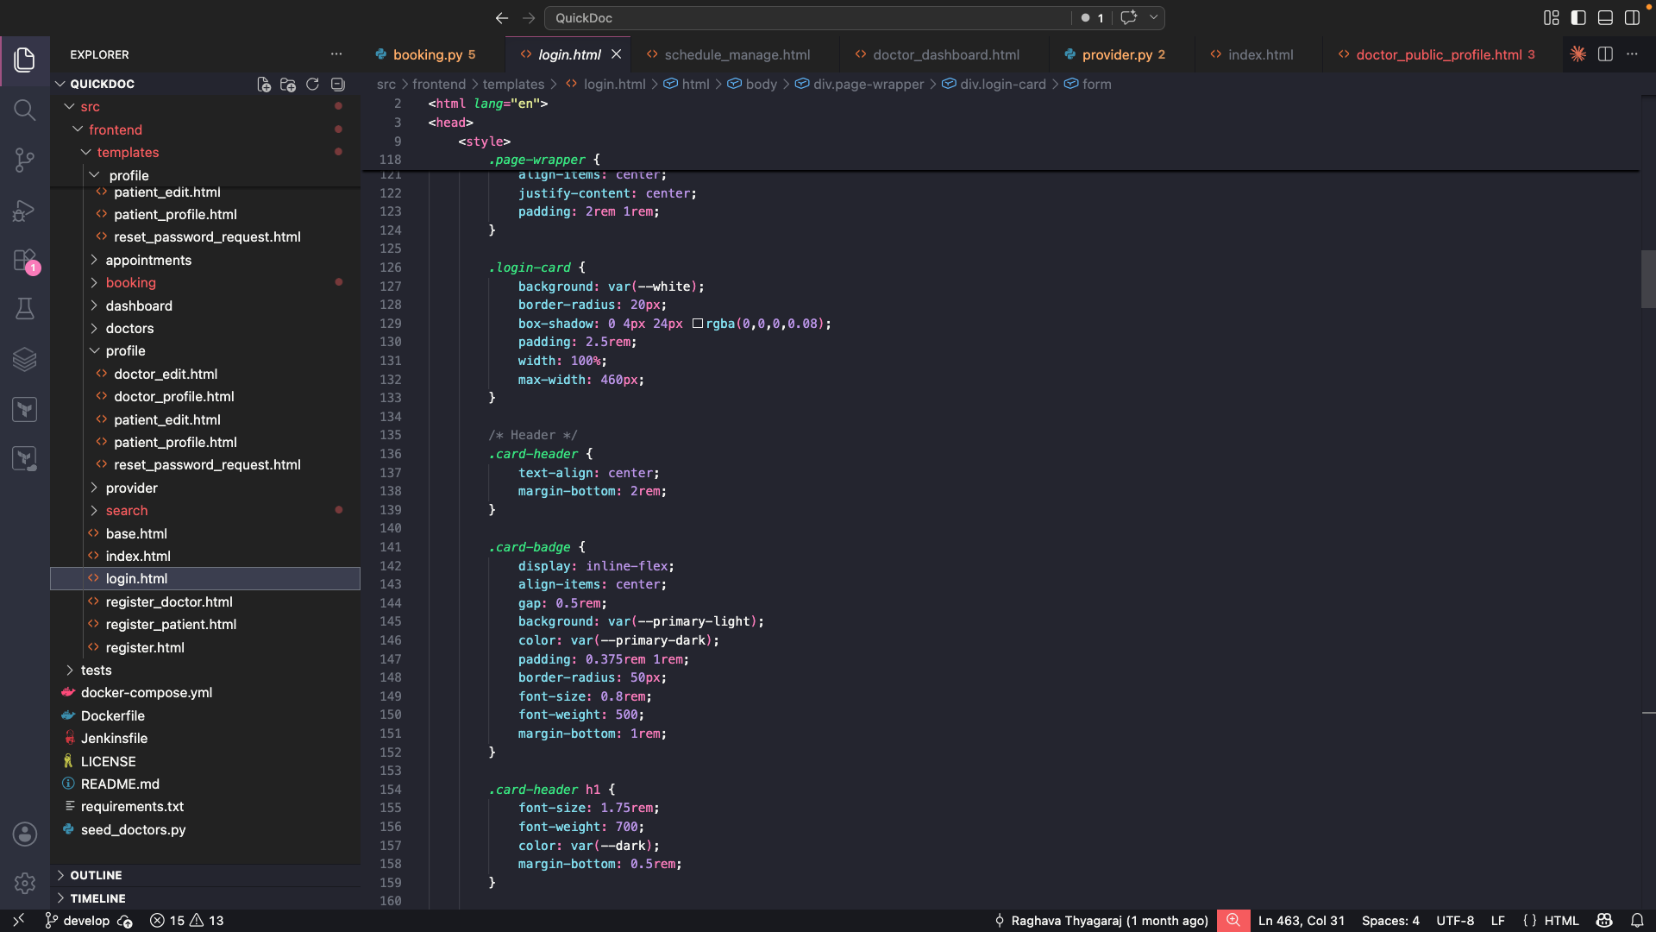
User Registration / Login (Frontend)
[ Insert Frontend Code Screenshot ]
QuickDoc | Team 4 | CS691 | Pace University

Slide 16
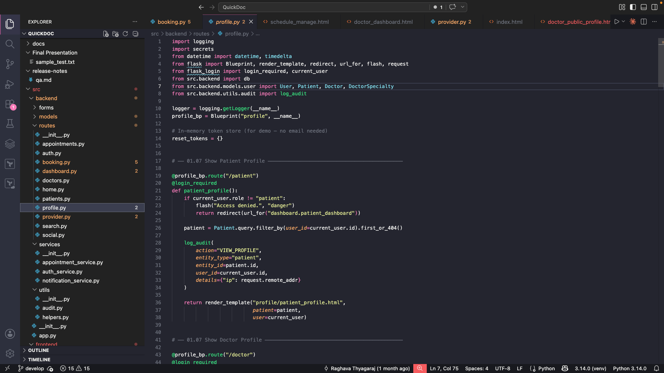
User Registration / Login (Backend)
[ Insert Backend Code Screenshot ]
QuickDoc | Team 4 | CS691 | Pace University

Slide 17
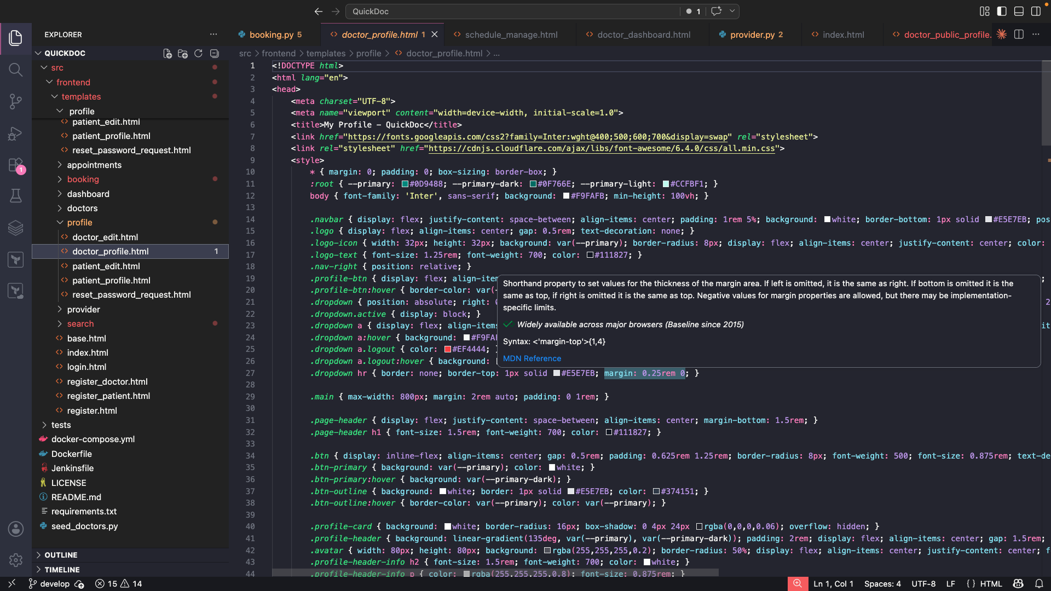
Doctor Profile (Frontend)
[ Insert Frontend Code Screenshot ]
QuickDoc | Team 4 | CS691 | Pace University

Slide 18
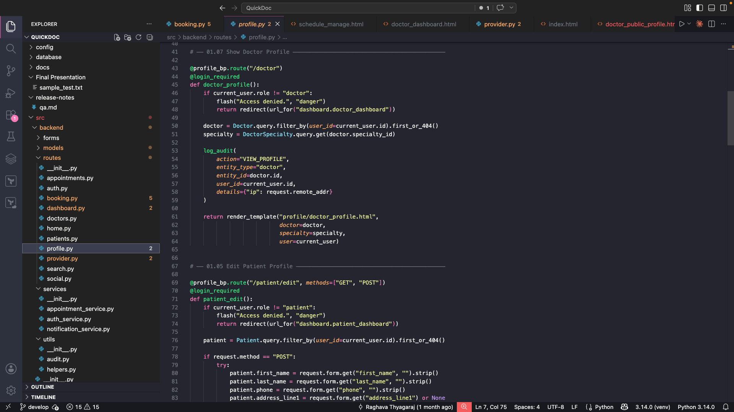
Doctor Profile (Backend)
[ Insert Backend Code Screenshot ]
QuickDoc | Team 4 | CS691 | Pace University

Slide 19

Deployment

Slide 20
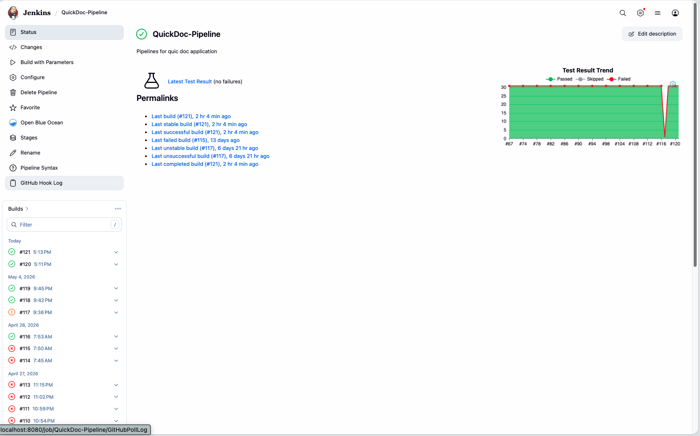
Jenkins Dashboard
[ Insert Jenkins Dashboard Screenshot ]
QuickDoc | Team 4 | CS691 | Pace University

Slide 21
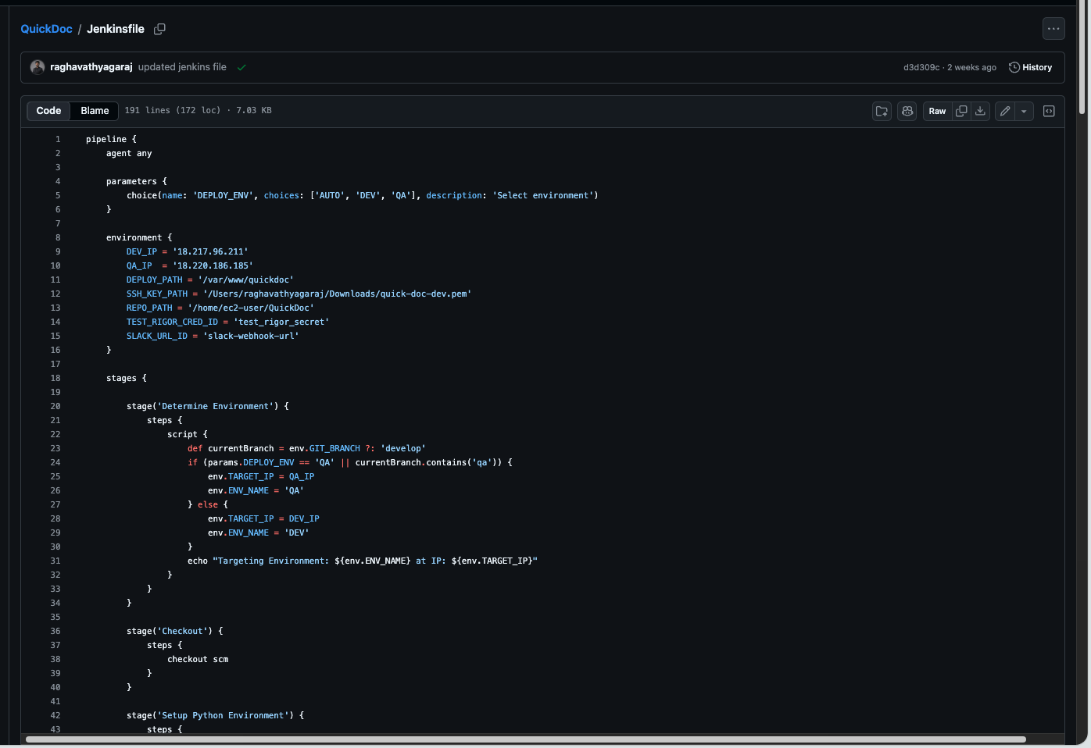
CI/CD Pipeline
[ Insert CI/CD Pipeline Screenshot ]
QuickDoc | Team 4 | CS691 | Pace University

Slide 22
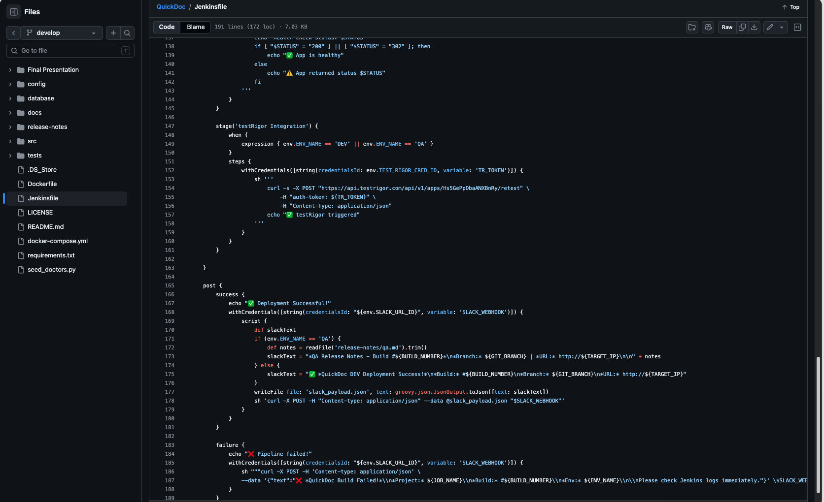
TestRigor Integration
[ Insert TestRigor Integration Screenshot ]
QuickDoc | Team 4 | CS691 | Pace University

Slide 23
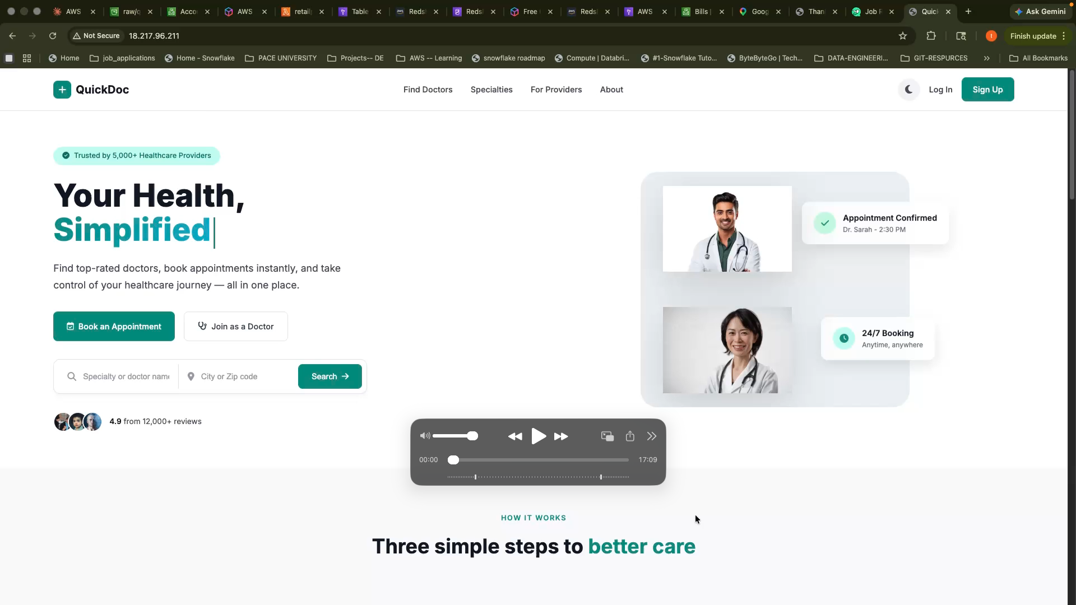
Application Live Demo
[ Insert Application Live Demo Screenshot ]
QuickDoc | Team 4 | CS691 | Pace University

Slide 24
Thank You!
QuickDoc • Team 4 • CS691 • Pace University

